Slide 1







Fire Alarm
Class: SE1816
Mentor: HoangTN11
Group 03 - IOT102

Slide 2


Members
Lê Anh Tuấn
Phạm Tấn Hưng
Phạm Thanh Điền
Nguyễn Thị Như Huỳnh
Lương Thị Diễm

Slide 3


Content
Problem and solution
Project Objective
Hardware Components
Circuit Diagram
Blynk web server
Working Principle
Conclusion

Slide 4

Problem and solution
Problem
Fire Risks: Fires can occur unexpectedly in areas with high temperatures, humidity, or gas/smoke leakage.
Lack of Monitoring: Many environments are not actively monitored for fire hazards, leading to delays in detecting potential dangers.

Slide 5

Problem and solution
Our solution:
Automatic fire alarm system: Using IoT technology, we aim to build a system that continuously monitors temperature, humidity and gas.
Alert: The system alerts users via LEDs and sirens as soon as dangerous conditions are detected.
Data display: Information is displayed on an LCD screen and users can monitor the system remotely via a cloud platform (e.g. Blynk).

Slide 6

Project Objective
Objective
Build an automatic fire alarm system with ESP32, DHT11 (temperature and humidity) sensors, and MQ2 (gas and smoke) sensors.

Slide 7
Project Objective
Features
Monitor the spray environment.
Alert for danger using LED lights.
Display important information on an LCD screen.
Protect areas at risk of fire.

Slide 8
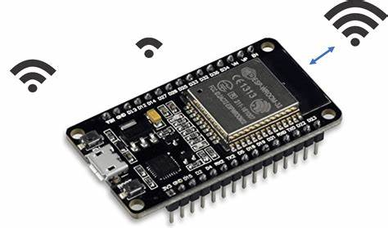
Hardware Components
ESP32 Wi-Fi module

Slide 9
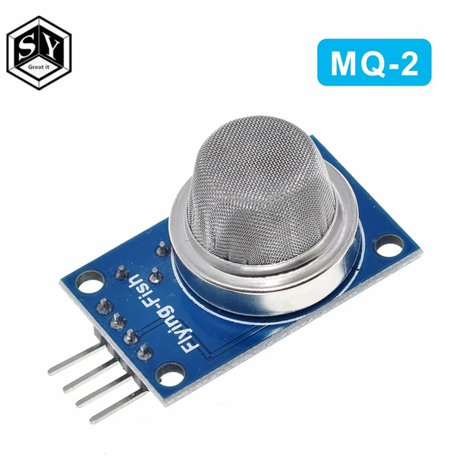
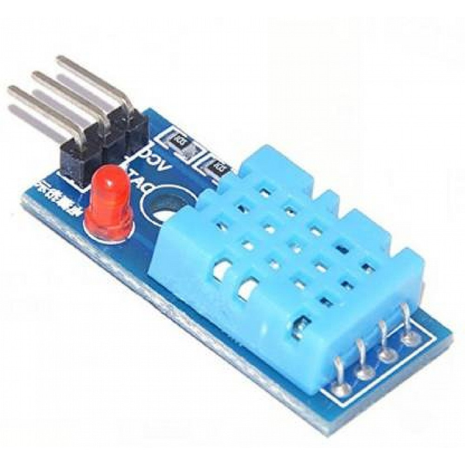
Hardware Components
MQ2 Gas Sensor
DHT11 Temperature and Humidity Sensor

Slide 10
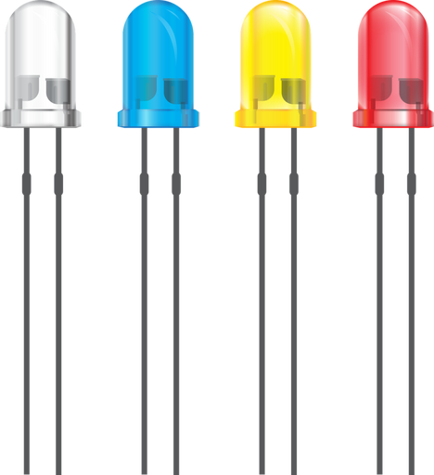
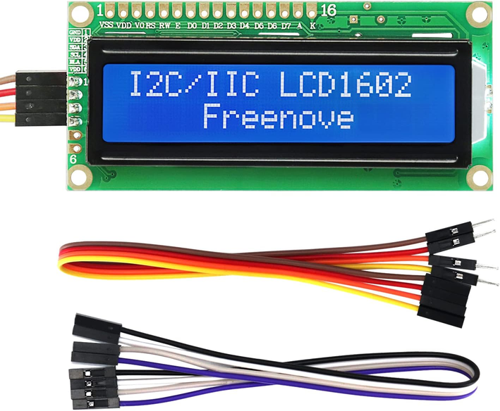
Hardware Components
LEDs
LCD 1602 I2C Display

Slide 11
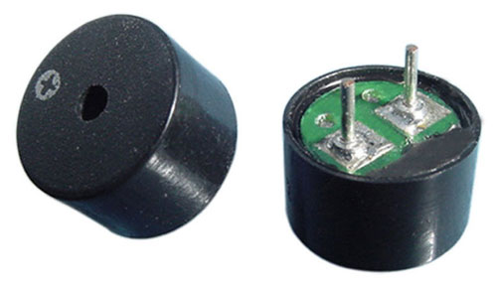

Hardware Components
Buzzer 9.5x12MM
Wires and Connectors

Slide 12
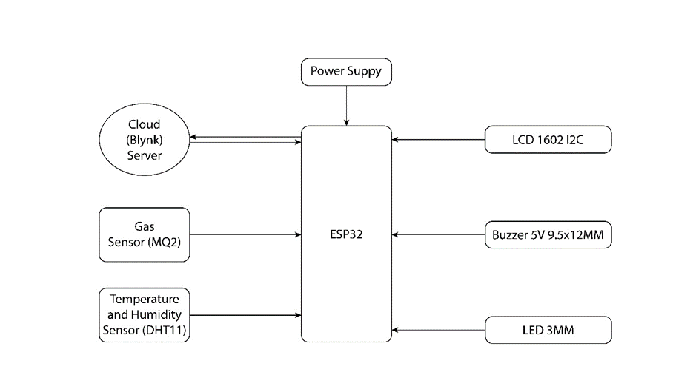
Circuit Diagram

Slide 13
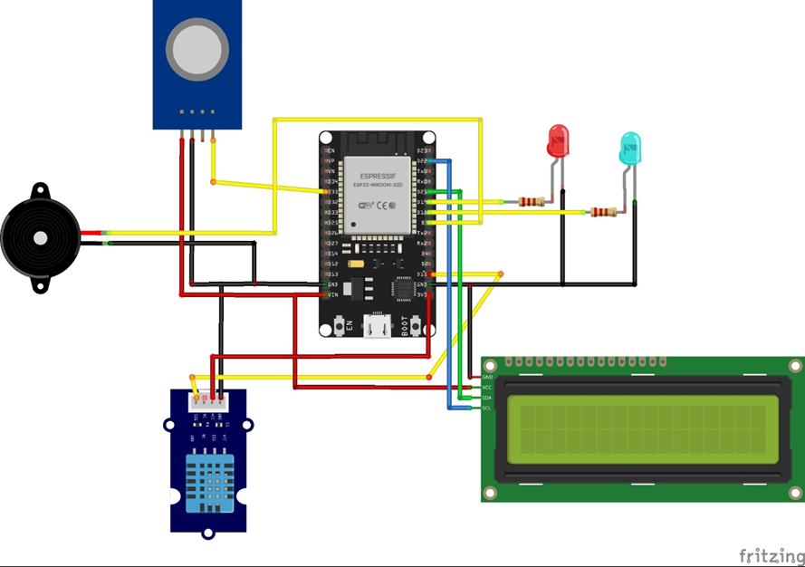
Circuit Diagram

Slide 14
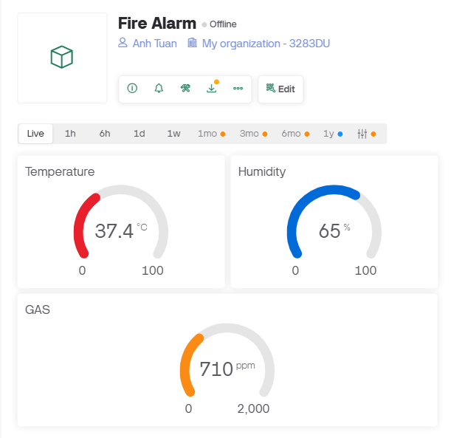
Blynk web server

Slide 15
Working Principle
The system constantly monitors the environment using the MQ2 and DHT11 sensors.
If gas or smoke levels exceed the threshold or if temperature and humidity readings are out of safe range, the system triggers the LEDs and buzzer.
Information is sent to the cloud and displayed on the LCD screen to alert users in real-time.

Slide 16

Conclusion
Effective Monitoring
Alert System
Real-Time Data Serial Monitor
Safety Enhancement
Cloud Integration
Quay lại Trang Chương trình

Slide 17
Thanks

